Slide 1
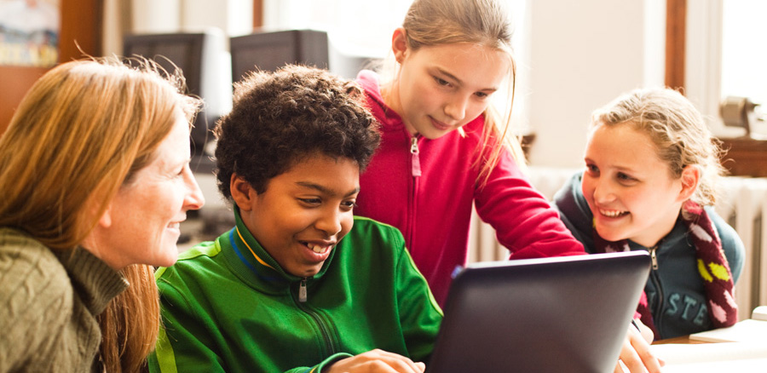
Partners in Learning School Research
Background
Microsoft 2013 All Rights Reserved.

Slide 2
Purpose: supporting reflection and common vision
The School Research is a tool that promotes a common language of innovative teaching and learning and supports school communities to more deeply reflect on innovative teaching practices.
The research also supports school leaders in making decisions about appropriate professional development for teachers and in making ICT investment decisions.
The research can be conducted every year to access changes in teaching practices. A school’s progress should be viewed from the perspective of building a culture of change and observing changes in teaching practices each year by a school’s key stakeholders.
2 | Microsoft 2013 All Rights Reserved.

Slide 3
History of Partners in Learning School Research
Microsoft’s Partners in Learning works with governments and educational organizations to help develop innovative teaching practices that improve student learning outcomes and better prepare youth for life and work in the 21st Century. We do this through programs that build the capacities of individual educators, grow learning communities among educators and school leaders, and expand teaching and learning practices in educational systems.
The Partners in Learning School Research is based on surveys developed for the international research project called Innovative Teaching and Learning (ITL) Research (www.itlresearch.com).
In 2009 and 2010, Microsoft’s Partners in Learning Innovative Schools Program conducted the ITL surveys, which measures innovative teaching practices, with school leaders and educators from 33 different countries. Each participating school received a report on their school’s practices in their local language. Schools which participated in this research said it was extremely valuable in helping them understand how to design learning that develops the skills students need for 21st Century life and work:
“The survey has started me thinking about my teaching strategies regarding ICT and my collaboration within my school.”
“I will use the survey as the basis for future departmental discussion.”
“Very good survey allowing me to reflect on my professional capacity as a Teacher.”
3 | Microsoft 2013 All Rights Reserved.

Slide 4
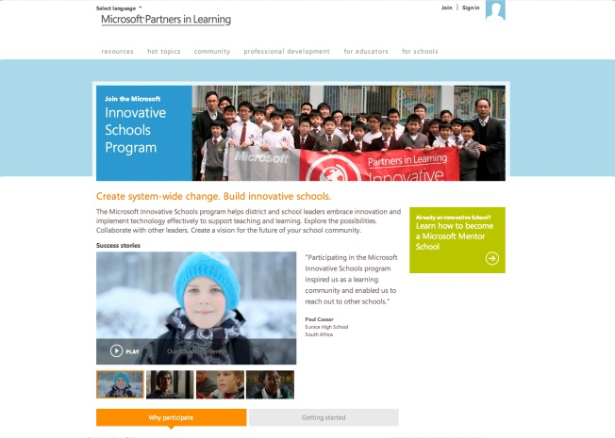
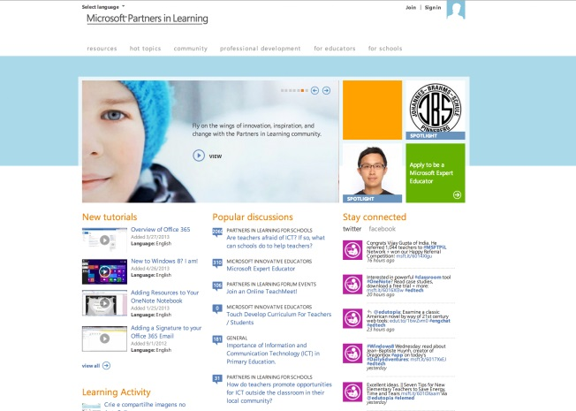
Microsoft Partners in Learning
Partners in Learning supports education transformation and achieving the goal of student centered learning through:
Research and Policy
ITL Research
School Leadership
Innovative Teaching Practices
Student Centered Learning
Education System Change
Building Capacities
Partners in Learning for Schools
Partners in Learning School Research
Growing Communities
Partners in Learning Network
Partners in Learning Forums
4 | Microsoft 2013 All Rights Reserved.

Slide 5
The ITL Research Project
ITL Research is a multiyear global research program that is sponsored by Microsoft’s Partners in Learning. ITL investigates innovative teaching practices, the conditions that enable educators to teach in new ways, and the resulting connection with students’ 21st century skills.
Primary Focus: To study innovative teaching practices and learning experiences.
It views ICT (technology) integration as an essential enabler for innovative teaching and learning.
The research has taken place in eight countries: Australia, Brunei, Finland, Indonesia, Mexico, Russia, Senegal and the United Kingdom.
www.itlresearch.com
5 | Microsoft 2013 All Rights Reserved.

Slide 6
ITL Research Model
The research design explores the complex ecosystem of influences that shape teaching and learning in national, school, and classroom contexts. The conceptual framework in the following diagram emphasizes a range of factors that extensive prior research has shown to be linked to teaching practices and deep student learning.
CONTEXT & INPUTS
PRACTICES
OUTCOMES
National
School & Teacher
Classroom
Student
School Culture and Supports
Education Policy
Innovative Teaching Practices
ICT Access and Supports
Students’ 21st Century Skills
Professional Development
Educator Attitudes
www.itlresearch.com
6 | Microsoft 2013 All Rights Reserved.

Slide 7
What are Innovative Teaching Practices?
Student-Centered Pedagogy
Innovative Teaching Practices
Extending learning beyond the classroom
Innovative Teaching Practices in the ITL Research Model include more than the use of information and communication technologies (ICT). Many examples show us that just putting technology in schools does not by itself change teaching and learning. We believe technology use needs to be part of cultural and pedagogical shifts that include student centered learning and practicing learning as something that takes place anytime and anywhere.
ICT used for teaching and learning
www.itlresearch.com
7 | Microsoft 2013 All Rights Reserved.

Slide 8
Elements of Innovative Teaching
We debated the use of the term “innovative” to describe the combination of these teaching practices, as student-centered pedagogy and extending learning beyond the classroom are concepts that have very long histories. The term “innovative” in this context is intended to connote the combination of existing things in new ways to solve problems. It is the combination of these pedagogical elements with technology that we believe has real potential for innovative solutions.
Student-Centered Pedagogy
In the ITL model, student-centered pedagogies include practices of teaching and learning that are project-based, collaborative, foster knowledge-building, require self-regulation and assessment. Additionally, these pedagogies are:
Personalized, by allowing for student choice and relevance to the individual student.
Individualized, by allowing students to work at their own pace and according to their particular learning needs.
Each of these elements has a strong base of prior research that links it to positive outcomes in development of 21st-century skills for students.
Extending learning beyond the classroom
This construct refers to learning activities that reflect the nature of high-performing work groups in modern organizations. For example, learning activities can extend beyond the traditional boundaries of the classroom by including individuals from beyond the classroom community (for example, parents, experts, community members), by providing opportunities for 24/7 learning (for example, research outside the classroom), fostering cross-disciplinary connections, and promoting global awareness and cultural understanding.
ICT used for teaching and learning
This construct relates to uses of technology by teachers and by students. The impact of information and communication technologies (ICT) can vary widely depending on its pedagogical application. Therefore, this construct includes a focus on how ICT is used and not simply whether it is used. For example, ITL measures distinguish between basic or rote use of technology and higher-level technology use supports students’ development of creative and collaborative skills for the 21st Century.
www.itlresearch.com
8 | Microsoft 2013 All Rights Reserved.

